Slide 1
Vendor Training Guide

Slide 2
Contents
Logging in to Sparkroom
Application Menu
Interfaces
Delivery Monitor
Operations
Form Post Instructions
Lead Inquiry
Results
Details
Reports
View Management
Lead Buyer Dashboards
View Management

Slide 3
Logging in
Once you get your login, you will enter your company name and password into the sign-in page

Slide 4
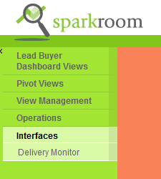
Application Menu
Application menu on the left hand panel
Can expand and hide the menu grid by clicking on double arrow on the top left

Slide 5
Interfaces: Delivery Monitor
Allows to search for leads transmitted to buyers during a certain timeframe
Can search by First Name, Last Name, LMS, Email, Branch Reference, CID
Filter by test leads/non test leads, response codes, Lead Buyers
Can only search back 31 days

Slide 6
Operations Form Post Instructions
Form Post Instructions can found in Sparkroom for each buyer leads are delivered to.
Click on channel to view instructions

Slide 7
Form Post Instructions
Contains detailed information out fields and response codes (ie. Max chars, required fields, description of field etc)

Slide 8
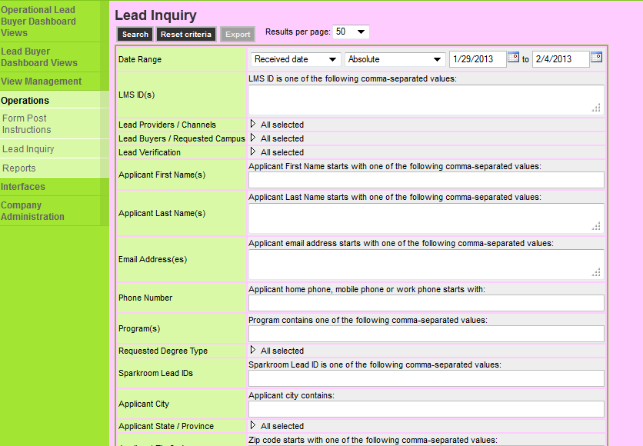
Operations Lead Inquiry
Interface to search for all leads transmitted to buyers within the past year
Advanced search criteria containing several items to search off

Slide 9
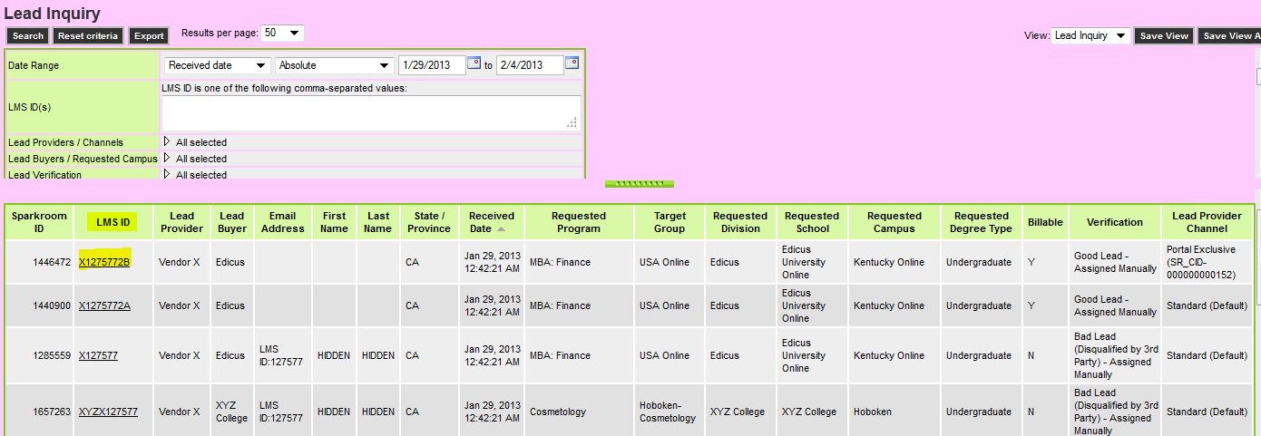
Lead Inquiry - Results
Perform a simple search and data will populate below grid
Click into any lead by clicking on “LMS ID” hyperlink
Can sort results by clicking on any of the header columns

Slide 10
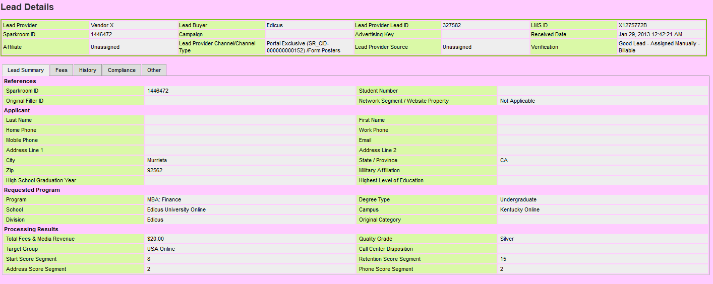
Lead Inquiry – Lead Details
Lead details screen shows detailed lead information
Tabs: Lead Summary, Feeds, History, Compliance, Other

Slide 11
View Management Lead Buyer Dashboard
Dashboards can be configured to provide analytical detail on several criteria
Can filter lead counts on Buyers, Channels, Dates etc

Slide 12
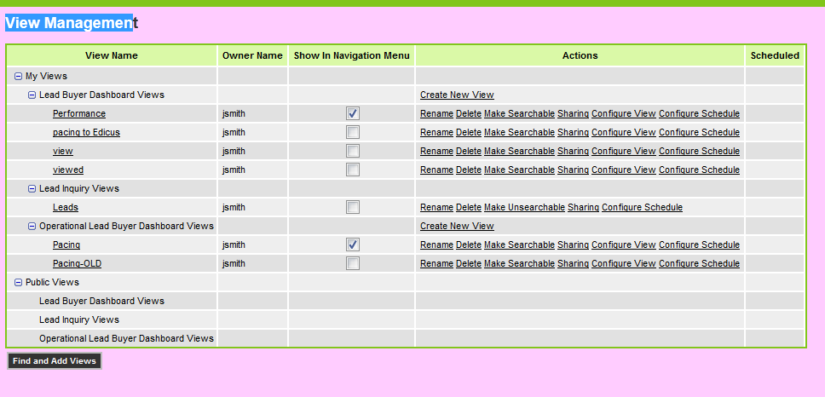
View Management

